Slide 1
QANTUS
KICK-OFF MEETING, 14-15th April 2014

Slide 2
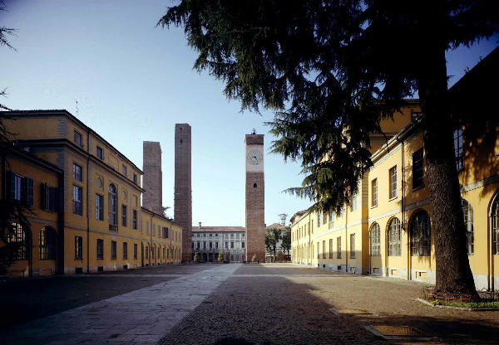
UNIVERSITA’ DEGLI
STUDI DI PAVIA
The University of Pavia (Universitas Studiorum
Ticinensis) has been active since 1361 (Studium
Generale established by Emperor Charles IV) even
though already in A.D. 835 (at that time Pavia was
the seat of the Holy Roma Empire) a school for the training of Imperial Officials had been established by Emperor Lotharius. At the time of the Austrian domination of Northern Italy, under Empress Maria Theresia it was the University
of choice for technical and medical training.
MAHEVA Kick-Off Meeting, 8-9-10 November at the University of Montpellier 2
Notes:
2

Slide 3
UNIVERSITA’ DEGLI
STUDI DI PAVIA
Some of its most illustrious Professors of the past:
Lazzaro SPALLANZANI (1729-1799, biologist and physiologist)
Lorenzo MASCHERONI (1750-1800. mathematician)
Alessandro VOLTA (1745-1827, physicist and discoverer of the battery)
Antonio SCARPA (1752-1842, surgeon and physician)
Vincenzo MONTI (1754-1828, poet and playwright)
Ugo FOSCOLO (1778-1827, poet and writer)
Carlo FORLANINI (1847-1918, physician and inventor of the pneumothorax)
Camillo GOLGI (1843-1926, physician and Nobel Prize for Medicine)

Slide 4
UNIVERSITA’ DEGLI
STUDI DI PAVIA
…… and of the present:
Giulio NATTA (1903-1979, chemist and Nobel Prize for Chemistry)
Carlo RUBBIA (1934- , physicist and Nobel Prize for Physics)
MAHEVA Kick-Off Meeting, 8-9-10 November at the University of Montpellier 2
Notes:
4

Slide 5
UNIVERSITA’ DEGLI
STUDI DI PAVIA
The University of Pavia operates on three campuses: the main one
in Pavia, and two dependencies: one in Mantova (Engineering) and one in Cremona (Faculty of Musicology). Overall, the University of Pavia currently offers 103 degree curricula (at BSc and MSc level) to 24000 students, through 9 Faculties and 1000 academic staff.
The University of Pavia has over 310 exchange agreements with
other Universities all over the World. It is a member of the Coimbra Group, an association of 39 high-status European Universities.
The University of Pavia has 15 University Residences for students, with one of the highest such ratios in Italy. It also features several Canteens, a Recreational Center with Swimming Pools, and offers students the possibility to practice several sports (from Archery to Canoeing to Rugby) and music (University Orchestra and Choir).
MAHEVA Kick-Off Meeting, 8-9-10 November at the University of Montpellier 2
Notes:
5

Slide 6
UNIVERSITA’ DEGLI
STUDI DI PAVIA
The University of Pavia is constantly ranked among the first 3 medium-sized Italian Universities based on a composite score.
The University of Pavia so far has generated 9 Academic Spinoff Companies operating in different research fields:
BRIGHT SOLUTIONS Srl, solid state lasers and optoelectronics
INVENTO Scrl, sensors, and innovative electronics
MICROGENOMICS Srl, genom analysis by Array-CGH techniques
PLASMORE Srl, portable biosensors
SPIREWARE Srl, medical devices in memory form alloys
UN.E.CO. Srl, innovative technologies for environmental protection
MAHEVA Kick-Off Meeting, 8-9-10 November at the University of Montpellier 2
Notes:
6

Slide 7
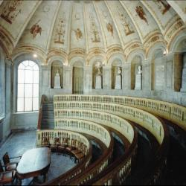
UNIVERSITA’ DEGLI
STUDI DI PAVIA
SOME IMAGES OF THE UNIVERSITY:
the Scarpa Anatomy Hall
MAHEVA Kick-Off Meeting, 8-9-10 November at the University of Montpellier 2
Notes:
7

Slide 8
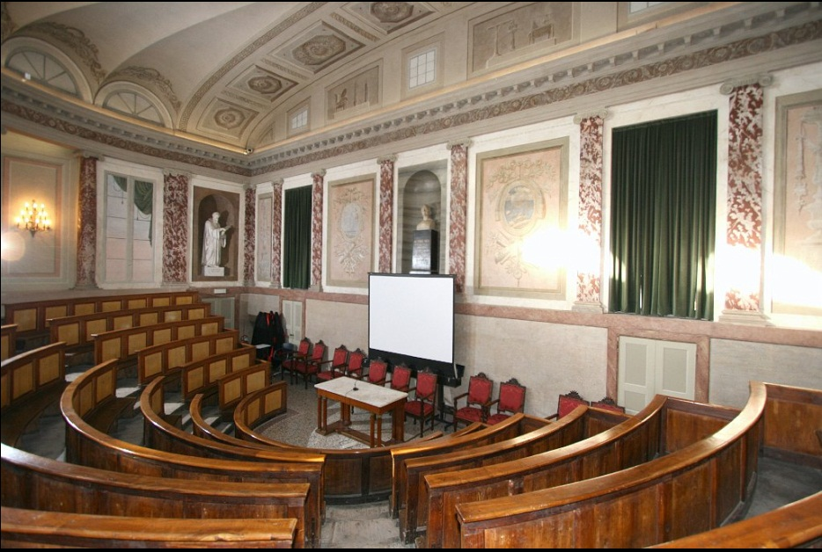
UNIVERSITA’ DEGLI
STUDI DI PAVIA
SOME IMAGES OF THE UNIVERSITY:
the Volta
Lecture Hall
MAHEVA Kick-Off Meeting, 8-9-10 November at the University of Montpellier 2
Notes:
8

Slide 9
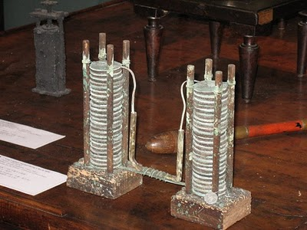
UNIVERSITA’ DEGLI
STUDI DI PAVIA
SOME IMAGES OF THE UNIVERSITY:
the Volta
experiment
set-up
MAHEVA Kick-Off Meeting, 8-9-10 November at the University of Montpellier 2
Notes:
9

Slide 10
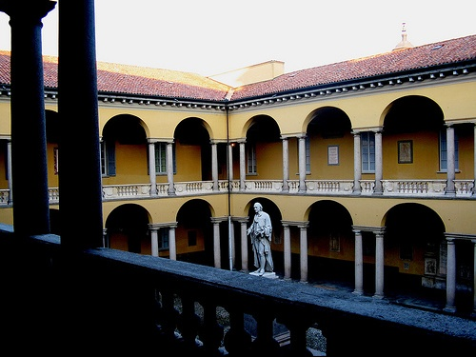
UNIVERSITA’ DEGLI
STUDI DI PAVIA
SOME IMAGES OF THE UNIVERSITY:
the main
court with statue of Volta
MAHEVA Kick-Off Meeting, 8-9-10 November at the University of Montpellier 2
Notes:
10

Slide 11
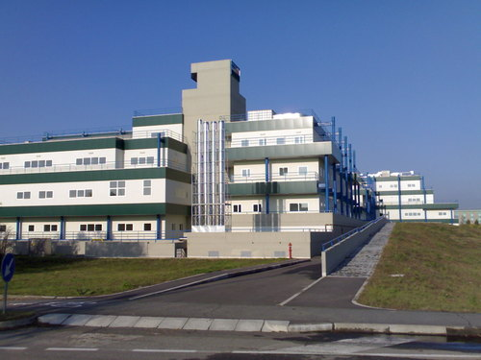
UNIVERSITA’ DEGLI
STUDI DI PAVIA
SOME IMAGES OF THE UNIVERSITY:
the new
technological/ medical
campus
MAHEVA Kick-Off Meeting, 8-9-10 November at the University of Montpellier 2
Notes:
11

Slide 12
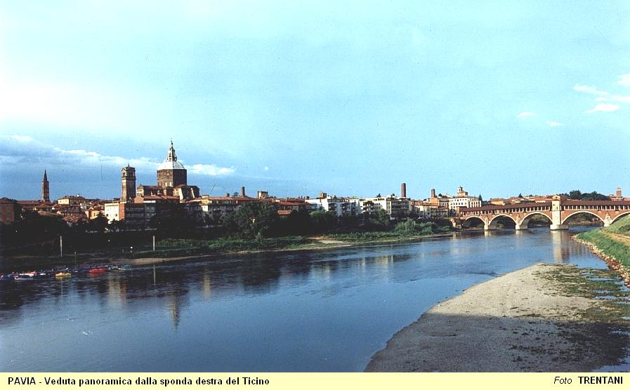
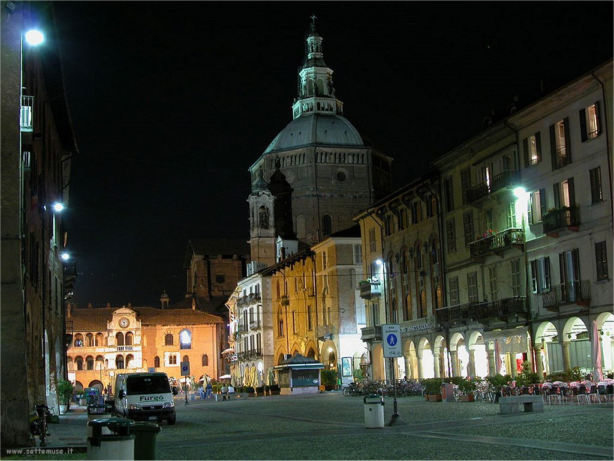
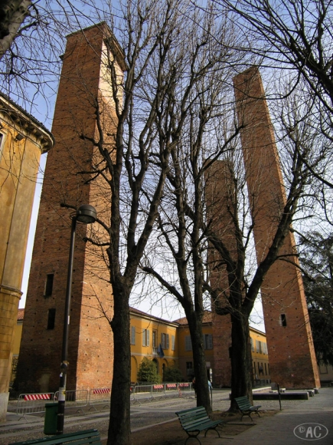
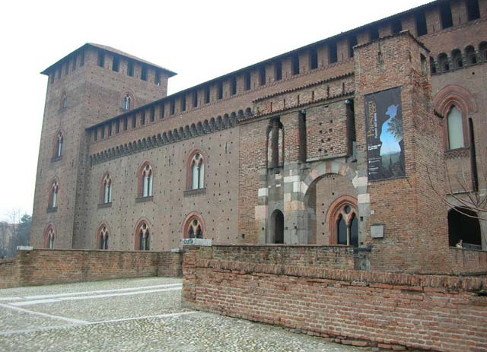
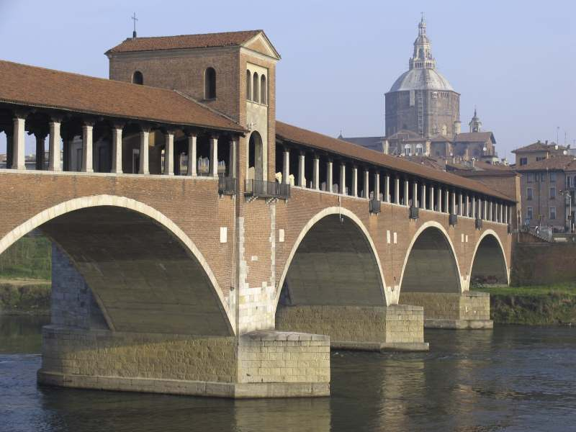
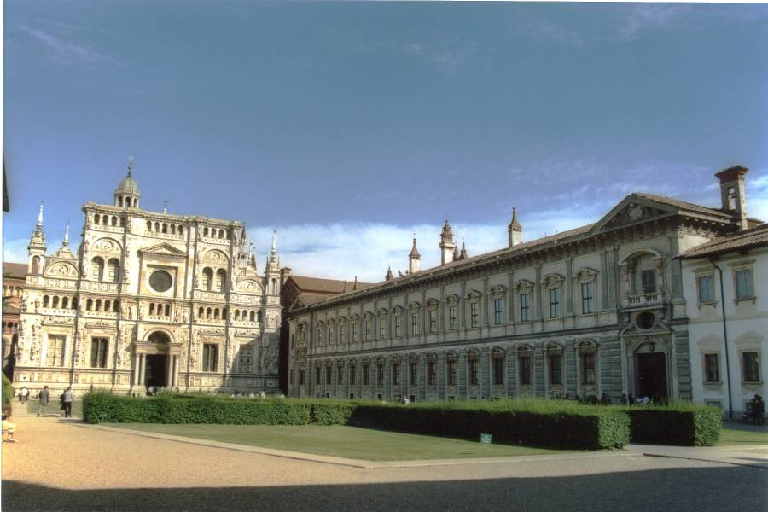
UNIVERSITA’ DEGLI
STUDI DI PAVIA
…. AND OF THE CITY :
MAHEVA Kick-Off Meeting, 8-9-10 November at the University of Montpellier 2
Notes:
12

Slide 13
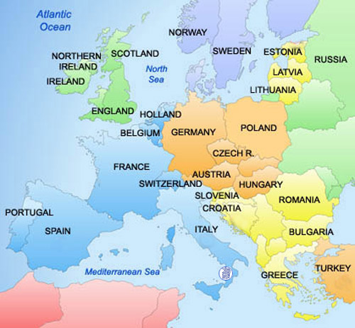
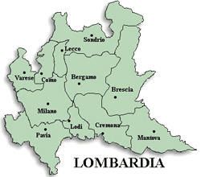
UNIVERSITA’ DEGLI
STUDI DI PAVIA
PAVIA IN EUROPE:
PAVIA is about 30 km south of Milan
80 km from Malpensa Airport
40 km from Linate Airport
80 km from Orio al Serio Airport
All the above are easily connected
to Pavia by bus and train
MAHEVA Kick-Off Meeting, 8-9-10 November at the University of Montpellier 2
Notes:
13

Slide 14
UNIVERSITA’ DEGLI
STUDI DI PAVIA
Fields of study in the MAHEVA themes:
The following Faculties are active at the University
Economics (BSc, MSc and PhD in Business, Economics, Management, International Cooperation)
Engineering (BSc, MSc and PhD in Civil, Environmental. Biomedical and Biotechnology, Industrial, Computer Science, Mechatronic, MSc in Architecture and Construction Engrg.)
Law (MSc and PhD)
Literature and Philosophy (BSc, MSc and PhD)
Medicine (MD and DO degrees, BSc and MSc in Health Professions)
Musicology (BSc, MSc and PhD)
Pharmacology (BSc, MSc and PhD in Pharmacology and Chemical and Pharmaceutical Technology)
Political Sciences (BSc, MSC and PhD in Political Sciences and International Relationships)
Science (Mathematics, Physics, Biology)
MAHEVA Kick-Off Meeting, 8-9-10 November at the University of Montpellier 2
Notes:
14

Slide 15
UNIVERSITA’ DEGLI
STUDI DI PAVIA
Fields of research in the MAHEVA themes:
There are 49 research Departments at the University
of Pavia. Some of the relevant activity can be so summarized:
Engineering – Environmental: water and wastewater treatment, solid wastes management, air pollution, water and groundwater pollution, contaminated sites remediation. Renevable energies
(energy from biomass, solar, Microbial Fuel Cells).
Engineering – Biomedical & Biotechnologies: IT in Sanitary Applications, Artificial Biological Tissues, Biomaterials, Artificial Vision, Intelligent Prostethics.
Medicine – Clinical and Laboratory-based research
Pharmacology – Pharmaceutical Chemistry, Applied Pharmacology, Biochemistry
Sciences – Ecology, Geology, Biology, Material Technology
Please visit the website www.unipv.it and click the “research” button. You will find an updated description of the current research topics
in the Department of your interest.
MAHEVA Kick-Off Meeting, 8-9-10 November at the University of Montpellier 2
Notes:
15

Slide 16
UNIVERSITA’ DEGLI
STUDI DI PAVIA
The University of Pavia was one of the first Italian universities to enact procedures for the internationalization of its academic system. Together with the Universities of Bologna and Siena, was the first to implement the ERASMUS Programme for foreign students (1988). Similarly, Pavia has been collaborating since the late 1980s, within the framework of the Coimbra Group (a group of the oldest and most prestigious European universities), on a number of projects for the “Europeanization” of the university system (i.e. implementation of the ECTS credit transfer system). These projects were subsequently approved by the European Union. Based on our experience we believe in the need to create opportunities for students to pursue international careers as well as to encourage international research activities. The University of Pavia has dedicated a portion of its international funds and human resources to developing countries through the establishment of the Centre for International Cooperation and Development (CICOPS).
MAHEVA Kick-Off Meeting, 8-9-10 November at the University of Montpellier 2
Notes:
16

Slide 17
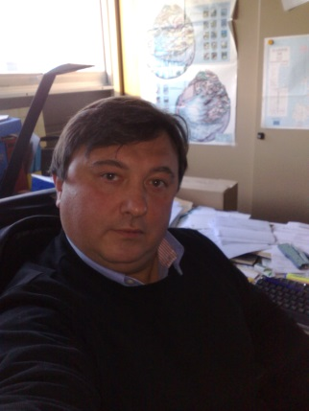
UNIVERSITA’ DEGLI
STUDI DI PAVIA
FOR ADDITIONAL INFORMATION/INQUIRIES PLEASE CONTACT:
Prof. Andrea G. CAPODAGLIO, PhD, PE
Dept. Of Hydraulic & Environmental Engrg.
capo@unipv.it
Phone & Fax +39 0382 985591
Skype: andrea.g.capodaglio
MAHEVA Kick-Off Meeting, 8-9-10 November at the University of Montpellier 2
Notes:
17

Slide 18
UNIVERSITA’ DEGLI
STUDI DI PAVIA
THANK YOU!!
… AND LOOKING FORWARD TO
A CELEBRATION TOAST IN
PAVIA
(ONE OF ITALY’S MOST REKNOWN WINE PRODUCING AREAS)
MAHEVA Kick-Off Meeting, 8-9-10 November at the University of Montpellier 2
Notes:
18

